Slide 1

Team Members:
Hima Kondepati,
Chowdhury Moinul Morshed Porag,
Robert McCain,
Martinez, Ryan K,
Vasquez, John,
Ibarbo, Francisco
Software Construction
LTL Presentation

Slide 2
Group Presentation - Outline
CRC Diagrams
Subsystem
Design patterns
Refactorings
Cohesion and coupling
Project Demo

Slide 3
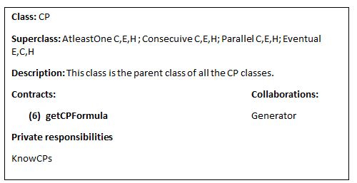
Group presentation - CRC Diagram
Based on CRC cards:
7 Subsystems
7 Contracts
Each subsystem contains the parent class and its child subclasses

Slide 4
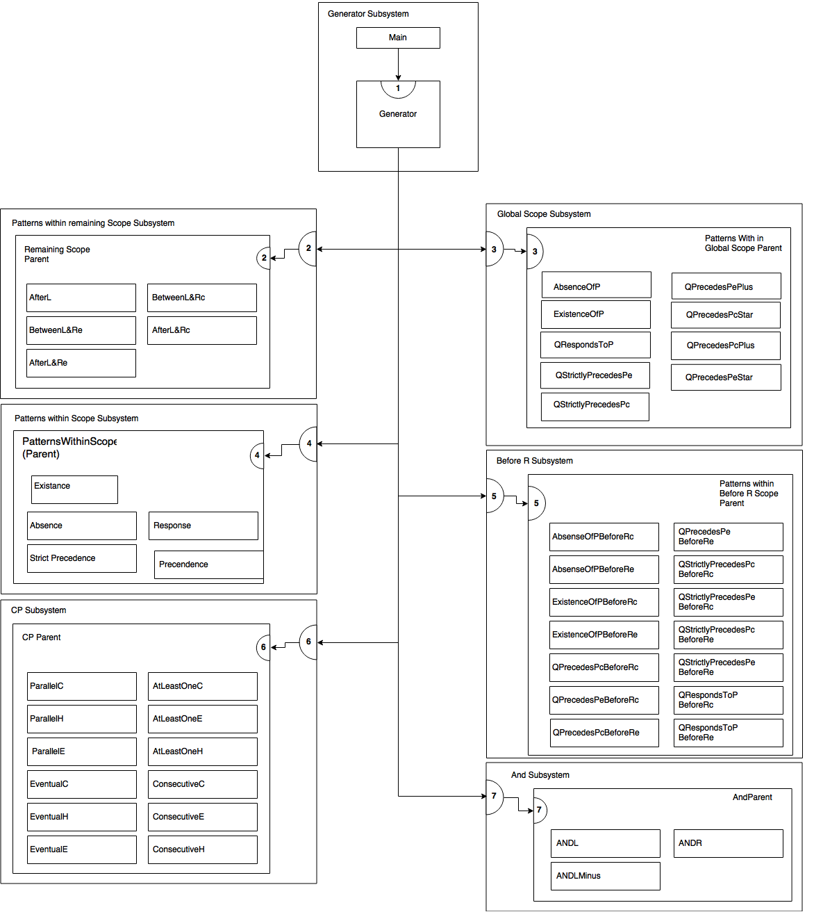

Slide 5
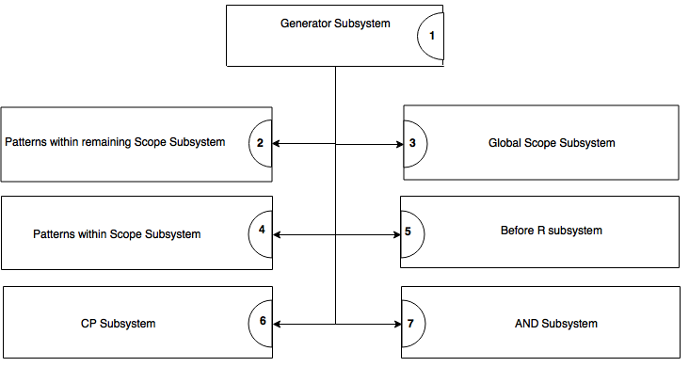
Group presentation - Subsystem

Slide 6
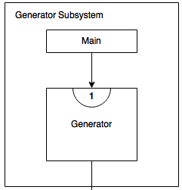
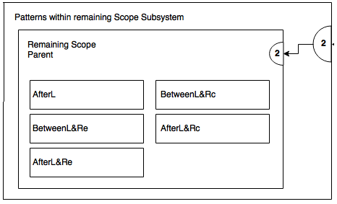
Group presentation - Subsystem

Slide 7
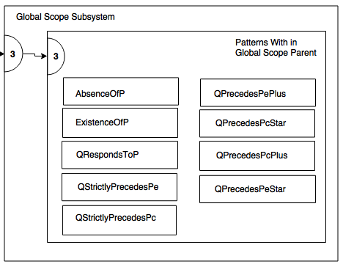
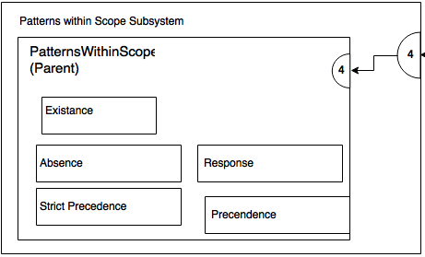
Group presentation - Subsystem

Slide 8
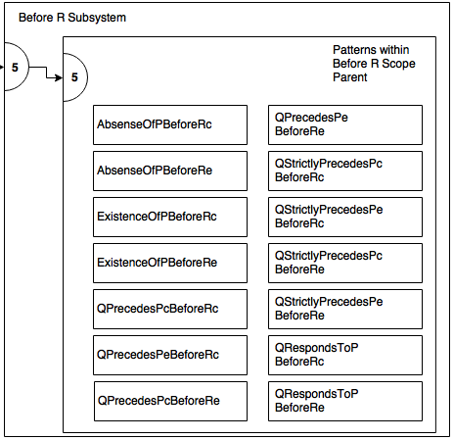
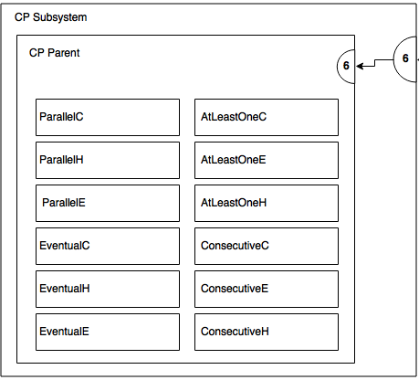
Group presentation - Subsystem

Slide 9
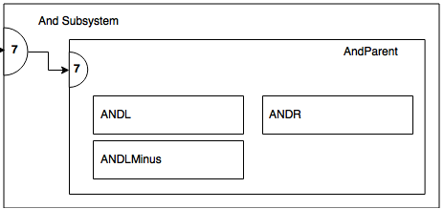
Group presentation - Subsystem

Slide 10
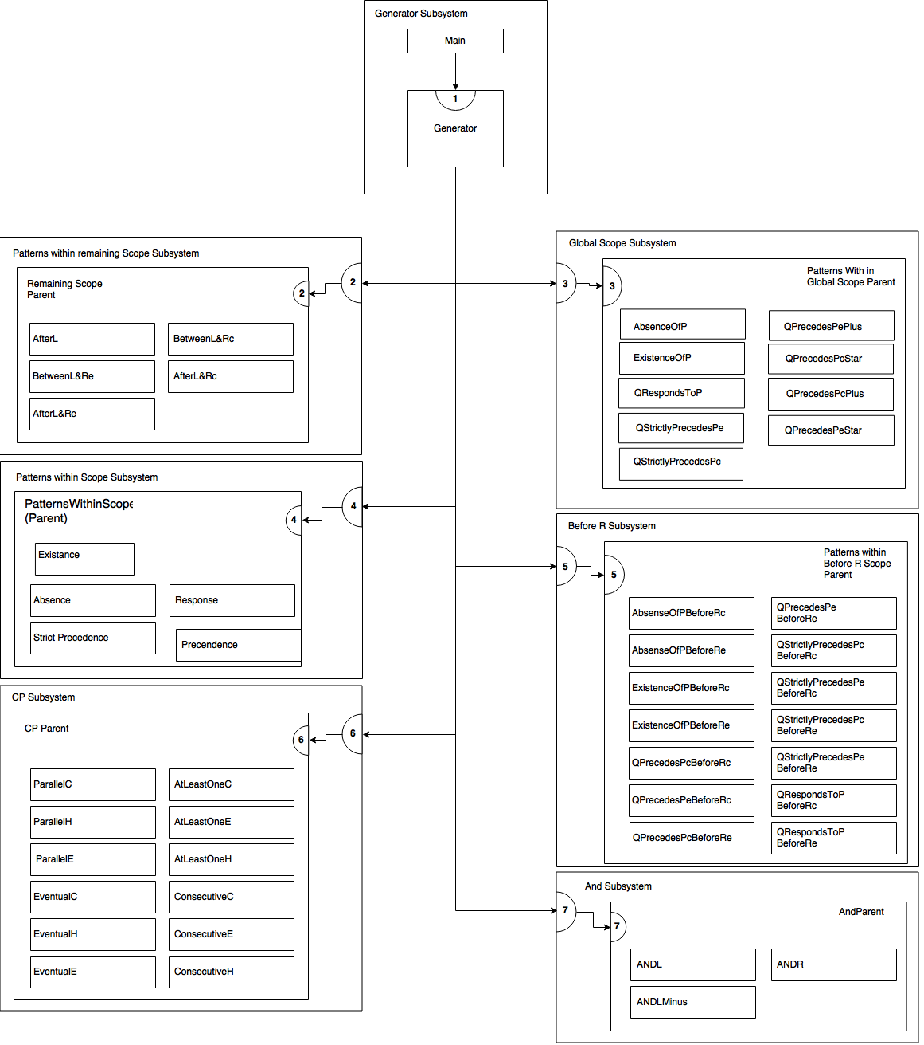

Slide 11
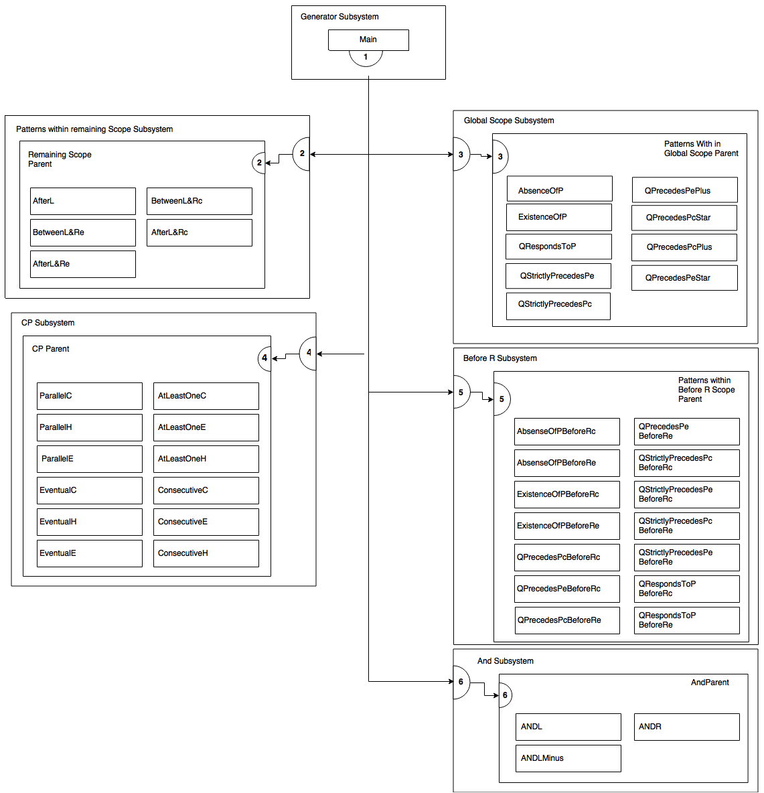

Slide 12
Group presentation - Design Patterns
Mediator Design Pattern

Slide 13
Mediator
1. Reduces Coupling
2. Reduces interaction and communication between classes
3. One class handles communication between all other classes

Slide 14
Group presentation - Refactoring
Add Parameter
Rename Method
Pull Up Method
Extract Methods
Replace Magic Numbers with symbolic constants
Extract Fields

Slide 15
Cohesion and Coupling
Cohesion - The degree to which the elements of a module belong together [1]. Cohesion measures the strength of relationship between pieces of functionality within a given module [1].
Coupling - The manner and degree of interdependence between software modules; a measure of how closely connected two routines or modules are; the strength of the relationships between modules [2].

Slide 16
Cohesion and Coupling (cont)
Does this system demonstrate high cohesion and low coupling? To some degree, yes.
Related classes share the same hierarchy.
Subsystems contain related classes.
Behaviors and fields related to the classes are cohesive to the classes they belong to.
Most classes do not require other classes to do their job.

Slide 17
Cohesion and Coupling (cont)
However, the system is not perfect.
The main class is heavily coupled to the rest of the subsystems.
There were additional associations that were not anticipated during development (Ex. BeforeR subsystem requires the And sub system, some classes require ParallelH). This means they are more tightly coupled than originally planned.
There are packages (symbols, regex, pattern, utility) and classes that were not originally planned for or modeled.

Slide 19
LTL Generator Demo
--Open here--

Slide 20
Individual Presentation (Robert)
Cards: AtLeastOneC, AtLeastOneH, AtLeastOneE, ConsecutiveC, ConsecutiveC, ConsecutiveH, and ConsecutiveE (Jointly with Ryan)
Pseudo code: AndL, AndR, AndMinusL
CRC diagram : And Sub System, System Contracts
CP’s : AtleastOneC, EventualE
AND: AndMinusL final vesion, AndR
BeforeR :
QPrecedesPcBeforeRc
QPrecedesPeBeforeRc
QStrictlyPrecedesPcBeforeRc
QStrictlyPrecedesPeBeforeRc

Slide 21
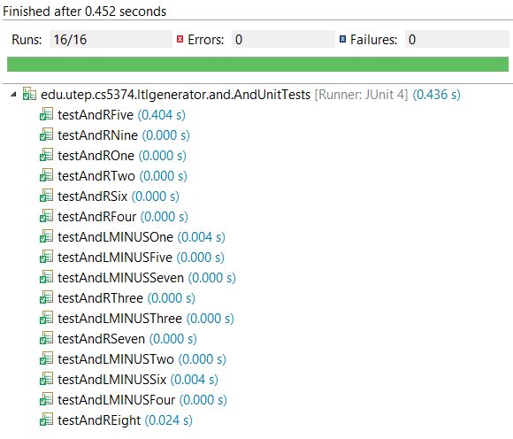
AndR & AndMinusL
After writing initial pseudo code and trying a couple of preliminary designs, I came upon one that solved the problem accurately. It is a general solution and works with all 3 And patterns. Solution works as follows:
Identify subformula and place them on a stack (respects order of operations).
Filter any duplicate results.
Resolve binary tokens (if any).
Process tokens as they are removed from the stack, anding any sub formula that need to be anded.
**We kept AndL since it already worked.

Slide 22
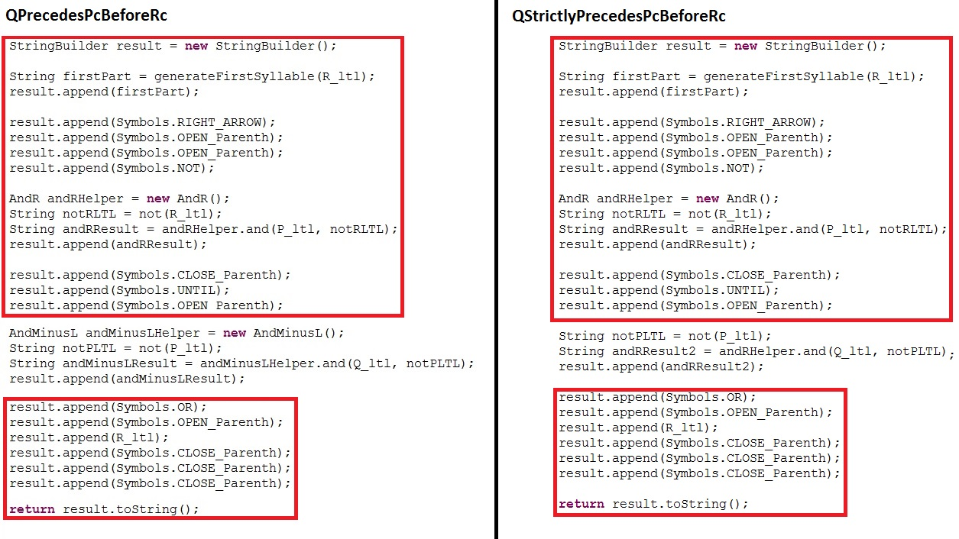
Fragment One: Duplicate Code

Slide 23
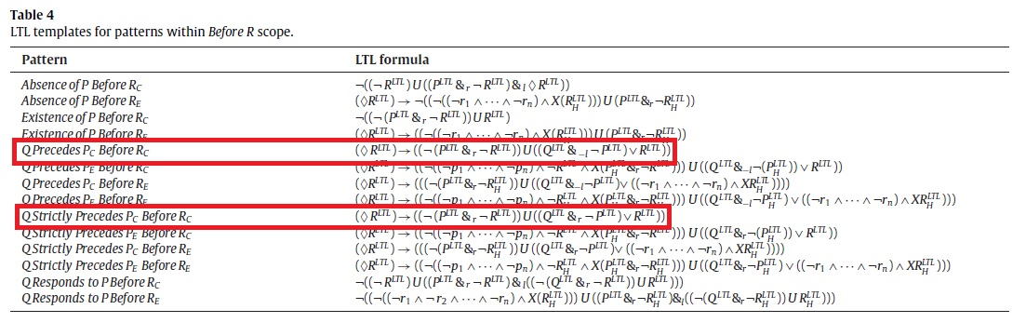
Sign of Duplicate Code
Only the second and expression vary!

Slide 24
How to fix
I chose to use form template method refactor to fix this smell.
Created QPrecedesPcBeforeRcParent and moved duplicate code fragments to it.
Introduced a template method in place of the varying code fragment.
Implemented the template method in the child classes.

Slide 25
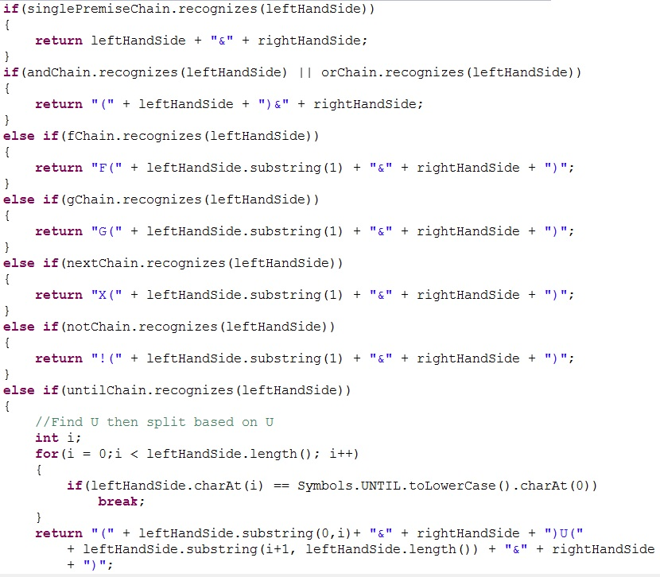
Fragment Two: Long Conditional
This code fragment was in the AndParent class. It was so long, in fact, that I couldn’t fit the whole code fragment on the slide. Smells: Long Method, Switch Statements.

Slide 26
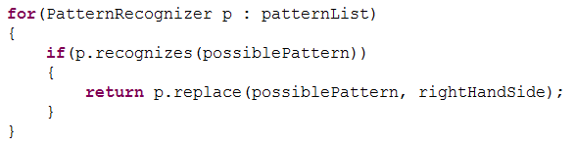
How to fix
Use the substitute algorithm refactor. Alternatively, the chain of responsibility design pattern could of been used. **Replace method belonging to PatternRecognizer class is not cohesive & another problem**

Slide 27
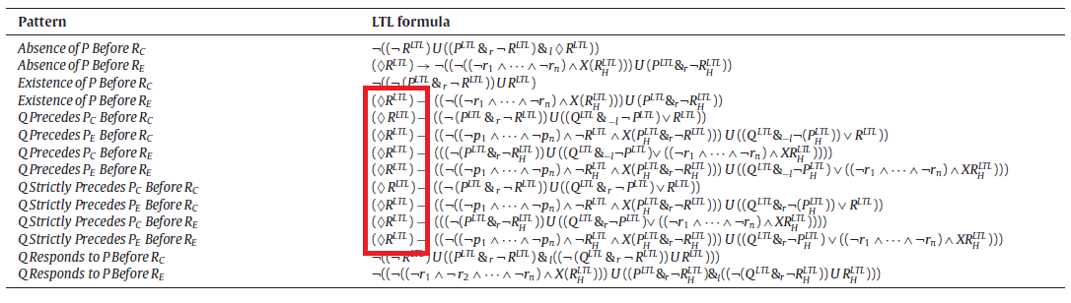
Another Refactoring Opportunity
If we take a closer look, this pattern seems to be repeated in many of the formula as well.

Slide 28
How to fix
Simply apply extract method and move it to the parent class.

Slide 29
Final Thoughts (For me at least)
And subsystem was over engineered and could of probably be solved linearly.
The regular expression library, although it provided convenience, was not needed and increases coupling.
Fields / Behaviors could of been analyzed further for better system cohesion.
There are a couple of classes (AndR, AndMinusL) that are simply lazy classes and are not needed.
Code should of been refactored more, walkthoughs conducted of the work that was completed, and more unit tests to cover the whole system.
More commenting and better documentation of source code.

Slide 30
Individual Presentation (Porag)
Cards : Patterns with in Global Scope
Pseudo code
CRC diagram : Patterns with in Global Scope, Global Scope Subsystem
CP’s :
ConsecutiveC : (p1 & X(p2 &(...(&Xpn))))
ParallelH : (p1 & . . . & pn)
AND: AndL
Global Scope : Q Strictly Precedes Pe, Q Precedes Pe+
BeforeR :
Q Precedes Pc before Re,
Q Strictly Precedes Pc before Re ,
Q Precedes Pe before Re,
Q Strictly Precedes Pe before Re

Slide 31
AndL
•(a₁| a₂ | a₃) &_{l} P = (a₁| a₂ | a₃) & P
•(a₁& a₂ & a₃) &_{l} P = (a₁& a₂ & a₃) & P
•(a₁ & X(a₂ & X a₃)) &_{l} P = (a₁ & X(a₂ & X (a₃ & P)))
•(a₁ & X(!a₂ U (a₂ & X(!a₃ U a₃)))) &_{l} P = (a₁ & X(!a₂ U (a₂ & X(!a₃ U (a₃ & P)))))
•(!a₁ & !a₂ & !a₃) & ((!a₁ & !a₂ & !a₃) U (a₁| a₂ | a₃)) &_{l} P = (!a₁ & !a₂ & !a₃) & ((!a₁ & !a₂ & !a₃) U ((a₁| a₂ | a₃) & P))
•(!a₁ & !a₂ & !a₃) & ((!a₁ & !a₂ & !a₃) U (a₁& a₂ & a₃)) &_{l} P = (!a₁ & !a₂ & !a₃) & ((!a₁ & !a₂ & !a₃) U ((a₁& a₂ & a₃) & P))
•(!a₁ & !a₂ & !a₃) & ((!a₁ & !a₂ & !a₃) U ((a₁& !a₂ & !a₃ & X(a₂ & !a₃ & X(a₃))))) &_{l} P
= (!a₁ & !a₂ & !a₃) & ((!a₁ & !a₂ & !a₃) U ((a₁& !a₂ & !a₃ & X(a₂ & !a₃ & X(a₃ & P)))))
•(!a₁ & !a₂ & !a₃) & ((!a₁ & !a₂ & !a₃) U (a₁& !a₂ & !a₃ &((!a₂ & !a₃) U (a₂ & !a₃ & (!a₃ U a₃))))) &_{l} P
= (!a₁ & !a₂ & !a₃) & ((!a₁ & !a₂ & !a₃) U (a₁& !a₂ & !a₃ &((!a₂ & !a₃) U (a₂ & !a₃ & (!a₃ U (a₃ & P)))))

Slide 32
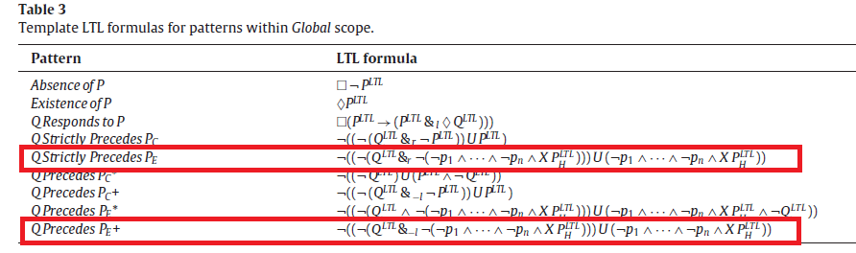
Global Scope

Slide 33
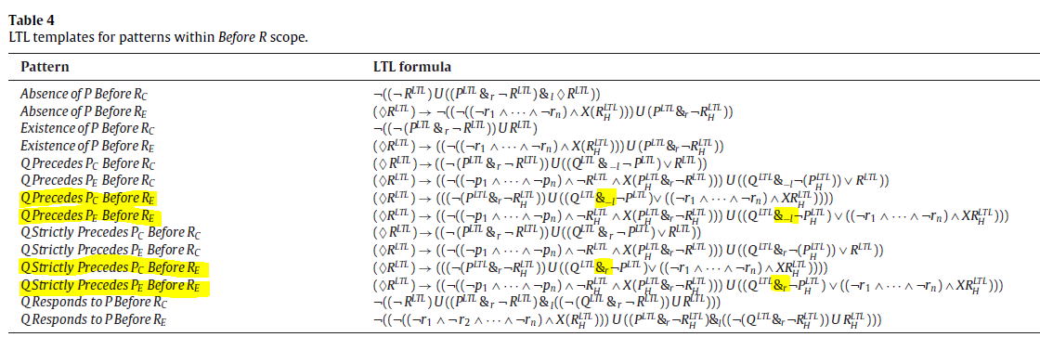
BeforeR

Slide 34
Individual Presentation (Hima)
Cards : PatternsWithinScopes (Table 2)
Pseudo code: Patterns Within The Remaining Scopes Subsystem RemainingScope, AfterL, BetweenLandRc, BetweenLandRe, AfterLUntilRc and AfterLUntilRe
CRC diagram : PatternsWithinScopes and its subsystem
CP’s : AtleastOneH, EventualC
AND: AndMinusL initial version
Global Scope : QRespondstoP
BeforeR :
QRespondsto P Before Rc
QResponds to P Before Re

Slide 35
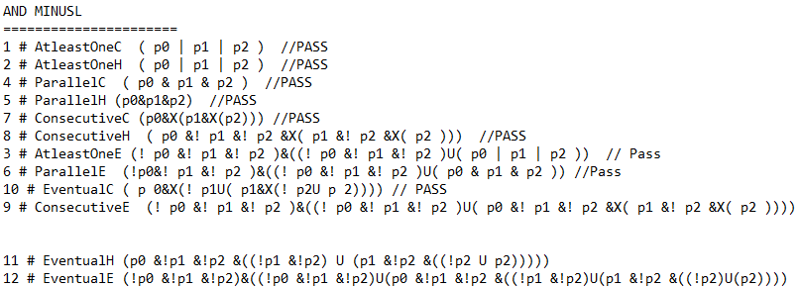
AndMinusL

Slide 36
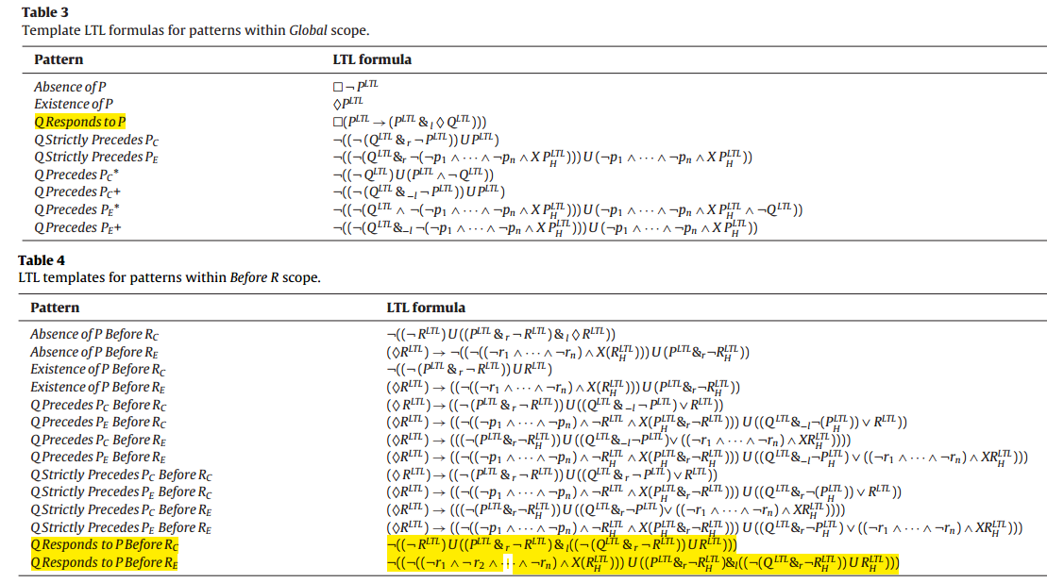
Global & BeforeR

Slide 37
Individual Presentation (John)
Cards : Cp table: Parallel E,C,H ; Eventual E,C,H; CP Abstract
Pseudo code: Cp’s above ^^, And Subsystem, generator Subsystem
CRC diagram : CP subsystem
CP’s : ConsecutiveH, ParallelE
AND: AndMinusL initial version
Global Scope :
Q Precedes Pe Plus
Q Precedes Pe Star
Q Precedes Pc Star
Q Precedes Pc Plus
Q Strictly Precedes Pc
BeforeR :
Existance of P before Re
Remaining Scopes:
After L until Rc
After L until Re

Slide 38
Individual Presentation (Francisco)
Cards : Global Scope, BetweenLandRc, Scope(Super), BeforeR, AfterLUntilRc, AfterLUntilRe, BetweenLandRc, AfterL
Pseudo code: written for all cards listed
CRC diagram : BeforeR Subsystem
CP’s : ParallelC, ConsecutiveE
BeforeR :
a: AbsenceofPBeforeRc
b: AbsenceofPBeforeRe
c: ExistenceofPBeforeRc

Slide 39
Individual Presentation (Ryan)
Cards: AtLeastOneC, AtLeastOneH, AtLeastOneE, ConsecutiveC, ConsecutiveC, ConsecutiveH, and ConsecutiveE (Jointly with Robert)
Pseudo code: ConsecutiveC, ConsecutiveH, ConsecutiveE
CRC diagram :
CP’s : EventualH, AtLeastOneE
Global Scopes : Absence of P, Existence of P
Remaining Scopes:
AfterL
BetweenLAndRc
BetweenLAndRe

Slide 40
Questions?
Q&A

Slide 41
References
[1] Wikipedia, 'Cohesion (computer science)', 2015. [Online]. Available: https://en.wikipedia.org/wiki/Cohesion_(computer_science). [Accessed: 03- Aug- 2015].
[2] Wikipedia, 'Coupling (computer science)', 2015. [Online]. Available: https://en.wikipedia.org/wiki/Coupling_(computer_programming). [Accessed: 03- Aug- 2015].

Slide 42
Thank you

